Slide 1
Lecture 10. Search (2/2)
Instructor: 黄群
huangqun@pku.edu.cn
School of EECS
Peking University

Slide 2
Outline
Search in hash table
General ideas of hashing (散列)
Hash functions
Deal with hash collisions

Slide 3
Ideal Searching
Given a key, get its position directly
Do not need to compare the key with others one by one
A constant number of comparison is tolerable

Slide 4
Hashing
Hashing is a technique used to perform insertions, deletions, and finds in constant average time.
Main contents:
What is hash table and hash functions?
How to resolve collision?
Open hashing
Close hashing

Slide 5
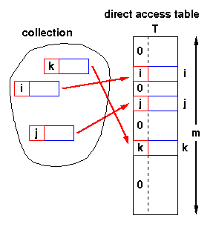
General Ideas
Hash table
A fixed-size array containing keys
Key mapping
Each key is mapped into one value deterministically
On insert/search/delete
Find an appropriate cell based on the mapped value

Slide 6
Example
A set of strings
Hash table
Mapping for a string key
the sequence number of its first character in {a, b, c, ..., z}
S = { and, array, begin, do, else, end, for, go, if, repeat, then, until, while, with}
char HT2[26][8];
H(key) = key[0] – ‘a’

Slide 7
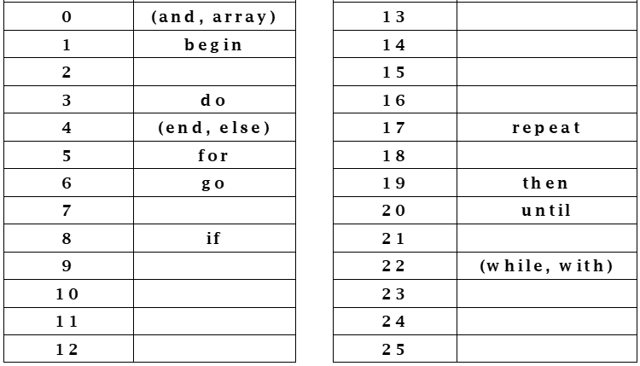
Example

Slide 8
Hash Functions
The mapping is called a hash function
Collision occurs when 2 or more keys are mapped to the same cell
Load factor α=n/m
Size of hash table m
Number of keys: n

Slide 9
Outline
Search in hash table
General ideas of hashing (散列)
Hash functions
Deal with hash collisions

Slide 10
Principles of Designing Hash Functions
Goals
Should be simple to compute
Better to evenly distribute the keys to the cells
Better to map two distinct keys to different cells

Slide 11
Principles of Designing Hash Functions
Issues to address
Key length
Size of hash table
The distribution of keys
Frequencies of keys
…

Slide 12
Commonly-Used Hash Functions
1. Division method (除余法)
2. Multiplication method (乘余取整法)
3. Middle square method (平方取中法)
4. Digit analysis method (数位分析法)
5. Radix conversion method (基数转换法)
6. Folding method (折叠法)
7. ELF hash function

Slide 13
Method 1: Division Method
h(x) = x mod M
Usually M is a prime number
Increase the likelihood of being uniformed distributed
The hash value depends on all bits of x, not only partial bits

Slide 14
If Not Choose Primer Number
If M is an even number
h(x) is even if x is even
h(x) is odd if x is odd
If x is more often an even (or odd) number
The hashed values would not be evenly distributed
If M is a power of 2 (or 10)
If M = 2^{k}, only the k least significant bits are used
If M = 10^{k}, only the k least significant digits are used
Not all the bits/digits are hashed

Slide 15
Method 1: Discussion
Disadvantages
The hashed values are contiguous if the keys are contiguous
The contiguous cells in the hash table may degrade the performance
Particularly when combined with some collision handling approaches

Slide 16
Method 2: Multiplication Method
Multiply key with a constant A (0 < A < 1)
Take the decimal part, denoted by x
Use ⎣x*n⎦ as the hash value for some integer n
hash ( key ) = ⎣ n * ( A * key - ⎣ A * key ⎦ ) ⎦

Slide 17
Method 2: Example
key = 123456
n = 10000 A = = 0.6180339，
hash(123456) =
= ⎣10000*(0.6180339*123456- ⎣ 0.6180339*123456 ⎦ )⎦
= ⎣10000 * (76300.0041151… - 76300)⎦
= ⎣10000 * 0.0041151…⎦ = 41

Slide 18
Method 2: Parameter Selection
Do not have strict requirement on n
So if the address space (i.e., size of hash table) has p bits
Just let n = 2^{p}
Knuth: A can be any value, depending on key distribution
is a good choice

Slide 19
Method 3: Middle Square Method
What if a hash table with size M=2^{k}?
h(x) = (x² mod 2^{w}) / 2^{w-k}
w = bitsize of (unsigned int);
Originally as a random number generator
by John von Neumann, 1949
w bits
x
x² mod 2^{w}
k bits
h(x)
Notes:
ENIAC: much faster than reading random numbers from punch cards

Slide 20
Method 3: Middle Square Method
Advantages
Contiguous keys are not hashed to contiguous addresses
M need not be a prime number
Multiplication (square) and shifting are faster than modulus
Disadvantages
It only consider a subset of bits of the keys
Keys which have a large number of leading (or trailing) zeros will collide

Slide 21
Method 4: Digit Analysis Method
Assume there are n keys, each with d digits, and each digit can be one of r symbols
The distribution of the r symbols on different digits may vary
The distribution on some digits may be uniform
The distribution on other digits may be highly uneven
We can pick the uniformly distributed digits for hashing

Slide 22
Method 4: Digit Analysis Method
Compute the “evenness” of distribution
α_{i}^{k} is the number of occurrence of the i-th symbol at the k-th digit
n/r is the expected number of occurrence of each symbol
The smaller λ_{k} is, the more even the symbols distributed at the k-th digit

Slide 23
Method 4: Example
λ₁ = (8 – 8/10)²×1
+ (0 – 8/10)²×9
= 57.6
λ₂ = (8 – 8/10)²×1
+ (0 – 8/10)²×9
= 57.6
λ₃ = (2 – 8/10)²×2 + (4 – 8/10)²×1
+ (0 – 8/10)²×7
= 17.6
λ₄ = λ₅ = λ₆
= (2 – 8/10)²×2 + (1 – 8/10)²×4
+ (0 – 8/10)²×4
= 5.6
9 9 2 1 4 8
9 9 1 2 6 9
9 9 0 5 2 7
9 9 1 6 3 0
9 9 1 8 0 5
9 9 1 5 5 8
9 9 2 0 4 7
9 9 0 0 0 1
① ② ③ ④ ⑤ ⑥

Slide 24
Method 4: Limitations
Digit analysis method is only suitable when
We know the distribution of digits of keys
The hash function has to be changed for a different set of keys

Slide 25
Method 5: Radix Conversion Method
Convert a key into another number base to obtain the hash value
View the digits of a key as the digits in another number system (usually with a larger radix)
Convert the number system back to the original
Truncate the converted number for the hash value

Slide 26
Method 5: Radix Conversion Method
Example: to map the key 210485 in the range 0 to 9999
If we view 210485 using base 13, we have
(210385)₁₃ = (771932)₁₀
We can use 1932 as the hash value

Slide 27
Method 6: Folding Method
The computation becomes slow if we use the Middle Square Method on a long number
Folding method
Divide the key into short numbers
Aggregate these short numbers to get the hash value

Slide 28
Method 6: Folding Method
Two kinds of folding
Shift folding (移位叠加)
Add the short numbers to get a hash value
Boundary folding (分界叠加)
Reverse every other short number, and add these numbers to get a hash value

Slide 29
Method 6: Example
A book with serial number: 04-42-20586-4
5 8 6 4
4 2 2 0
+ 0 4
[1] 0 0 8 8
h(key)=0088
(a) Shift Folding
0 4
4 2 2 0
5 8 6 4
0 2 2 4
4 0
+
0 4
6 0 9 2
h(key)=6092
(b) Boundary Folding

Slide 30
Method 7: ELF Hash Function
// used in the UNIX ELF format for object files
int ELFhash(char* key) {
unsigned long h = 0;
while(*key) {
h = (h << 4) + *key++;
unsigned long g = h & 0xF0000000L;
if (g) h ^= g >> 24;
h &= ~g;
}
return h % M;
}

Slide 31
Method 7: Benefits
Work for both long and short keys
Every character (digit) in the key matters
Better distributed in hash table

Slide 32
Outline
Search in hash table
General ideas of hashing (散列)
Hash functions
Deal with hash collisions
Open hashing
Close hashing

Slide 33
Open Hashing
Called Separate Chaining (分离链表) in some textbooks
Key idea
Keep a list of all elements that hash to the same value
Notes:
draw on blackboard

Slide 34
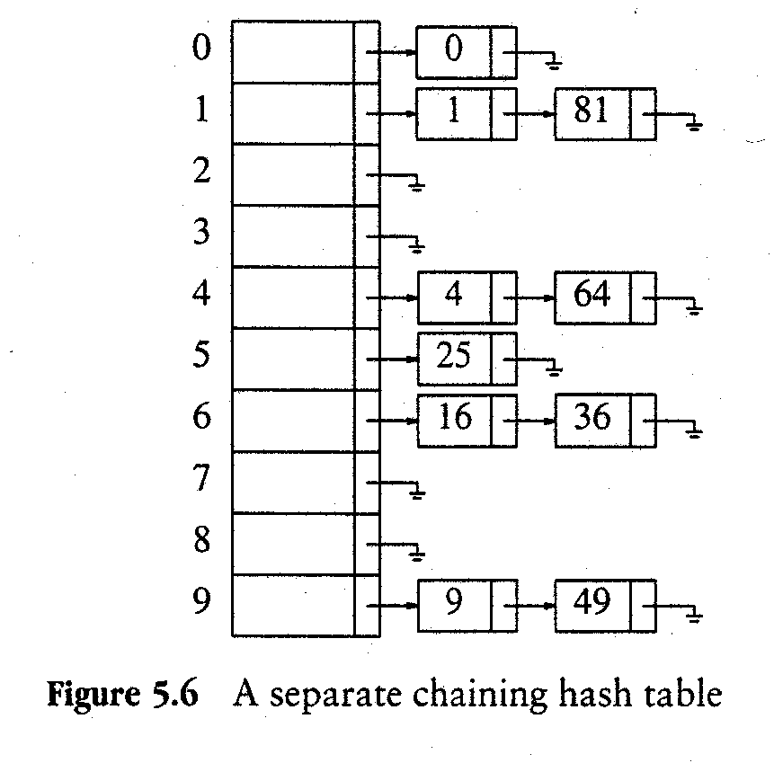
Separate Chaining
Example: Hash (X) = X mod 10
Data sequence:
0, 1, 4, 9, 16, 25, 36, 49, 64, 81

Slide 35
Sample Code: Interfaces
// Type declaration for separate chaining
struct ListNode;
typedef struct ListNode *Position;
struct HashTbl;
typedef struct HashTbl *HashTable;
HashTable InitializeTable (int TableSize);
void DestroyTable (HashTable H);
Position Find (ElementType Key, HashTable H );
void Insert (ElementType Key, HashTable H);
/* Routines such as Delete and MakeEmpty are omitted */

Slide 36
Sample Code: Data Structure
struct ListNode {
ElementType Element;
Position Next;
};
typedef Position List;
struct HashTbl {
int TableSize;
List *TheLists;
};

Slide 37
Sample Code: Init
/* Allocate array of lists */
H->TheLists
= malloc (sizeof (List) * H->TableSize);
if (H->TheLists == NULL)
FatalError ("Out of space!!!");
/* Allocate list headers */
for (i = 0; i < H->TableSize; i++) {
H->TheLists [i] = malloc
(sizeof (struct ListNode));
if (H->TheLists [i] == NULL)
FatalError ("Out of space!!!");
else
H->TheLists [i]->Next = NULL;
}
return H;
}
// Initialization routine for separate chaining
HashTable InitializeTable (int TableSize) {
HashTable H;
int i;
if (TableSize < MinTableSize) {
Error ("Table size too small");
return NULL;
}
/* Allocate table */
H = malloc (sizeof (struct HashTbl));
if (H == NULL)
FatalError ("Out of space!!!");
H->TableSize = NextPrime (TableSize);

Slide 38
Sample Code: Find
// Find routine for separate chaining
Position Find (ElementType Key, HashTable H) {
Position P;
List L;
L = H->TheLists [Hash (Key, H->TableSize)];
P = L->Next;
while (P != NULL && P->Element != Key)
/* Probably need strcmp!! */
P = P->Next;
return P;
}

Slide 39
Sample Code: Insert
// Insert routine for separate chaining
// insert in the front of the chain
void Insert (ElementType Key, HashTable H) {
Position Pos, NewCell;
List L;
Pos = Find (Key, H);
if (Pos == NULL) { // Key is not found
NewCell = malloc (sizeof (struct ListNode));
if (NewCell == NULL)
FatalError ("Out of space!!!");
else {
L = H->TheLists [Hash (Key, H->TableSize)];
NewCell->Next = L->Next;
// Probably need strcpy!
NewCell->Element = Key;
L->Next = NewCell;
}
}
}

Slide 40
Analysis
Search time: time to hash + time to search a list
Average list length = λ (load factor)
Successful search requires about 1 + λ/2 links to be traversed.
Unsuccessful search requires about 1 + λ links to be traversed.

Slide 41
Discussion
Make the table size as large as the expected number of elements
Lead to constant search time on average
Chaining could be through a list or a tree.
A disadvantage of separate chaining is that
it requires a second data structure for the chains,
time is required for the allocation of new cells on insertion,
it is usually not suitable for external storage

Slide 42
Outline
Search in hash table
General ideas of hashing (散列)
Hash functions
Deal with hash collisions
Open hashing
Close hashing

Slide 43
Close Hashing
d₀=h(K): base location for key K
If collision occurs, additional locations are generated
d₁，d₂，... d_{i} ，... ， d_{m-1}
Probe the locations to find an empty one
Assumption
At least one address is empty
Otherwise:
Infinite search unless we limit the maximum search number

Slide 44
Problem: Clustering
Potential problem: Clustering（聚集）
Generate same following locations
Lead to long sequence
Primary clustering
Different base locations have the same following locations
Secondary clustering
Different keys exhibit hash collisions, then generate same following locations

Slide 45
Possible Methods
Method 1: Linear Probing
Method 2: Quadratic Probing
Method 3: Pseudo-Random Probing
Method 4: Doubling Hashing

Slide 46
Method 1: Linear Probing
Try consecutive locations (with wraparound)
Base location: d
Probe:
Pros
Every slot can be used for a given key
Cons
Primary clustering, leading to long probing sequence
d+1，d+2，......，M-1，0，1，......，d-1

Slide 47
Method 1: Example
M = 15, h(key) = key%13
If next key follows a uniformed distribution
With probability 2/13, next key is put in location 11
With probability 9/13, next key is put in location 7

Slide 48
Method 1: A Variant
Base location: d
For the i-th value in the probing sequence
d_{i} = (d + c*i) Mod M
C is a constant integer, C and M are relatively prime
However, clustering remains
Example: c = 2，h(k₁) = 3，h(k₂) = 5
Probing sequence of k₁: 3、5、7、9…
Probing sequence of k₂: 5、7、9…

Slide 49
Method 2: Quadratic Probing
The probing function is quadratic
d_{2i-1} = (d +i²) % M
d_{2i} = (d – i²) % M
Example: M = 13, h(k₁)=3, h(k₂)=2
Sequence of k₁: 3, 4, 2, 7, ...
Sequence of k₂: 2, 3, 1, 6, ...

Slide 50
Method 2: Discussion
Pros: Eliminates the primary clustering problem
Cons:
No guarantee that all cells are tried
No guarantee of finding an empty cell once the table gets more than half full, or even before the table gets half full if the table size is not prime

Slide 51
Method 3: Pseudo-Random Probing
The probing function is determined by a pseudo-random sequence
d_{i} = (d + perm[i - 1]) Mod M
perm[i] is a pseudo-random sequence
Generated in preprocessing

Slide 52
Method 3: Example
Assume
M = 13
perm[0] = 2, perm[1] = 3, perm[2] = 7
h(k₁) = 4, h(k₂) = 2
Probing sequences
k₁: 4, 6, 7, 11, …
k₂: 2, 4, 5, 9, …
Solves the primary clustering problem, but not the secondary clustering problem

Slide 53
Method 4: Doubling Hashing
Root cause of secondary clustering
d_{i} only depends on base location d
Original key is not considered
Double hashing: introduce another hash function to calculate d_{i}
d_{i} = (d + i * h₂ (key)) % M

Slide 54
Method 4: Discussion
Let h₂ (key) and M be relatively prime
When two keys collide in one location, the following locations are evenly distributed over the table
Pros: solve secondary clustering
Cons: additional computation overheads

Slide 55
Method 4: Parameter Selection
Selection 1:
M is prime
1 ≤ h₂ (K) ≤ M – 1
Selection 2:
M = 2^{m}
h₂ (K) is an odd between 1 and 2^{m}
Selection 3:
M is primer: h₁(K) = K mod M
h₂ (K) = K mod (M-2) + 1, or h₂(K) = [K / M] mod (M-2) + 1
Selection 4:
M is arbitrary integer, h₁(K) = K mod p (p is largest prime less than M)
h₂ (K) = K mod q + 1 ( q is largest prime less than p)

Slide 56
Outline
Search in hash table
General ideas of hashing (散列)
Hash functions
Deal with hash collisions
Open hashing
Close hashing
Implementation
Analysis

Slide 57
Dictionary ADT
Elements are (key, value) tuple
Main operations
Can be realized by hash tables
bool hashInsert(const Elem&);
// insert(key, value)
bool hashSearch(const Key&，Elem&) const;
// lookup(key)

Slide 58
Dictionary Class (Close Hashing)
template <class Key，class Elem，class KEComp，class EEComp> class hashdict {
private:
Elem* HT; // Hash table
int M; // Maximum size
int current; // # of current element
Elem EMPTY; // Empty element
int h(int x) const ; // hash functions
int h(char* x)const ;
int p(Key K，int i) // Calculate probing locations
public:
hashdict(int sz，Elem e) {
M=sz; EMPTY=e; currcnt=0; HT=new Elem[sz];
for (int i=0; i<M; i++) HT[i]=EMPTY;
}
~hashdict() { delete [] HT; }
bool hashSearch(const Key&，Elem&) const;
bool hashInsert(const Elem&);
Elem hashDelete(const Key& K);
int size() { return currcnt; }
};

Slide 59
Insert Operation
To insert key K with hash function h
Calculate location h(K)
Case 1: the location is empty, insert to the location
Case 2: K is already in the location, report duplicated key
Case 3: another key in the location
Probe each following location, until find an empty one

Slide 60
Insert Operation: Sample Code
// Insert e into HT
template <class Key, class Elem, class KEComp, class EEComp>
bool hashdict<Key, Elem, KEComp, EEComp>::hashInsert(const Elem& e) {
int home= h(getkey(e)); // base location
int i=0;
int pos = home; // Start
while (!EEComp::eq(EMPTY, HT[pos])) {
if (EEComp::eq(e, HT[pos])) return false;
i++;
pos = (home+p(getkey(e), i)) % M; // Probe
}
HT[pos] = e; // Insert
return true;
}

Slide 61
Lookup Operation
Similar to Insert Operation
To lookup key K with hash function h
Case 1: Empty, return lookup miss
Case 2: probe each location from the base
If key match, return lookup hit
If no key match at the end (get an empty location), return lookup miss

Slide 62
Lookup Operation: Sample Code
template <class Key, class Elem, class KEComp, class EEComp>
bool hashdict<Key, Elem, KEComp, EEComp>::
hashSearch(const Key& K, Elem& e) const {
int i=0, pos= home= h(K); // Start
while (!EEComp::eq(EMPTY, HT[pos])) {
if (KEComp::eq(K, HT[pos])) { // Lookup hit
e = HT[pos];
return true;
}
i++;
pos = (home + p(K, i)) % M;
} // while
return false;
}

Slide 63
Delete Operation
Need to address two issues
Deleted elements cannot affect future lookup operations
Released locations can be re-used by future insert operations
Open hashing: additional list to store conflict elements
Simply delete element from the list
Close hashing: cannot actually delete
Actual delete: break a probing sequence of others
Lookup operations cannot work correctly
Solution: add a mark (tombstone) to deleted elements

Slide 64
Delete Operation: Example
h(k1) = 2，h(k2) = 6
Probe sequence of k1: 2、3、1、6、11
Probe sequence of k2: 6、7、5、10、2、9、3
Now delete element in location 6
Move last element (location 2) in K2 sequence to location 6
Fail to lookup K1 in the future

Slide 65
Mark Tombstone
A special mark means that:
The location records an element before
The location is not used now

Slide 66
Delete Operation with Tombstone
template <class Key, class Elem, class KEComp, class EEComp>
Elem hashdict<Key,Elem,KEComp,EEComp>::hashDelete(const Key& K)
{ int i=0, pos = home= h(K); // Start
while (!EEComp::eq(EMPTY, HT[pos])) {
if (KEComp::eq(K, HT[pos])){ // Lookup deleted element
temp = HT[pos];
HT[pos] = TOMB; // Mark tombstone
return temp; // Return deleted element
}
i++;
pos = (home + p(K, i)) % M;
}
return EMPTY;
}

Slide 67
Insert Operation with Tombstone
Can we reuse a location with tombstone?
Still need to travel all probing locations until an empty
Check duplicate keys

Slide 68
Insert Operation with Tombstone: Code
template <class Key, class Elem, class KEComp, class EEComp>
bool hashdict<Key, Elem, KEComp, EEComp>::hashInsert(const Elem &e) {
int insplace, i = 0, pos = home = h(getkey(e));
bool tomb_pos = false;
while (!EEComp::eq(EMPTY, HT[pos])) {
if (EEComp::eq(e, HT[pos])) return false;
if (EEComp::eq(TOMB, HT[pos]) && !tomb_pos)
{insplace = pos; tomb_pos = true;} // Record first tombstone
pos = (home + p(getkey(e), ++ i)) % M;
}
if (!tomb_pos) insplace=pos; // No tombstone, use the empty location
HT[insplace] = e; return true;
}

Slide 69
Outline
Search in hash table
General ideas of hashing (散列)
Hash functions
Deal with hash collisions
Open hashing
Close hashing
Implementation
Analysis

Slide 70
Methodology
# of element access for insert, lookup, delete
Insert and delete also depend on lookup
Delete: need to find the element first
Insert: check all possible locations for duplicated elements

Slide 71
Key Factor
Load factor determines lookup efficiency
Load factor: α= N/M
Small α: an element is nearly its base location
Large α: long probing sequence

Slide 72
Analysis
Assume M > N
Collision in base location with probability α= N/M
Collision for the first i locations
With large N and M, approximate it by ( N/M )^{i}
Expect number of element access (including the last element)

Slide 73
Analysis
As the hash table grows, α also increases
The average cost of multiple insert operations

Slide 74
Discussion
Cost is constant for low α
In practice, if insert and delete are frequent, need to rehash all elements
Clear tombstone

Slide 75
Summary
Search in hash table
General ideas of hashing (散列)
Hash functions
Deal with hash collisions
Open hashing
Close hashing
Implementation
Analysis

Slide 76
More Usage of Hash
More hash-based data structures
For random choice
…

